Slide 1
PROJECT PRESENTATION
Name : Manoj M
NM ID : au713921106027
Email id. : manojisac68@gmail.com
Project Title: Environment Monitoring
Phase-3 : Development

Slide 2
ABSTRACT
The level of pollution has increased with times by lot of factors like the increase in population, vehicle use, industrialization and urbanization which results in harmful effects on human wellbeing by directly affecting health of the people. This project is based on the wireless sensor networks for collecting information about Environment.
Develop an IOT Based Environmental Monitoring System, it can monitor the public Parks by using the Wi-Fi Technology. Internet of Things provide support for huge and accurate amount of data regarding the Environment. In this IOT project, we can monitor the pollution level from anywhere through computer or mobile.
This system,we can forecast to avoid future pollution and can send the warning message to that particular polluted area.

Slide 3
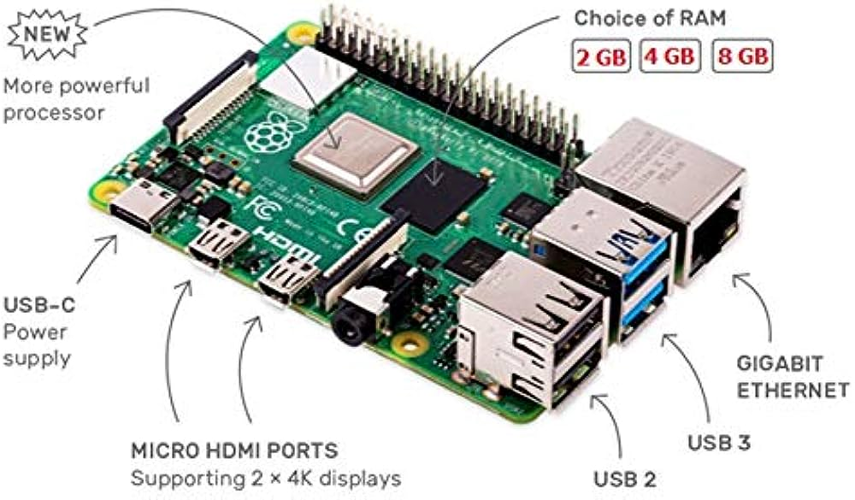
The best solutions for IoT in Python
Python on Raspberry Pi
The first thing that comes to mind about running Python on an IoT device is grabbing of Raspberry Pi from the table. Python is pre-installed in the operating system and the only thing left is for write own script for our desired output.
We can control the I/O ports on the Raspberry Pi expansion bar. Fortunately, the board supports wireless communication (Bluetooth and WiFi), Ethernet, and we can also connect a monitor to the HDMI outputs,or a low energy consumption E-Ink 2.13" 250x122 display for Raspberry Pi.

Slide 4
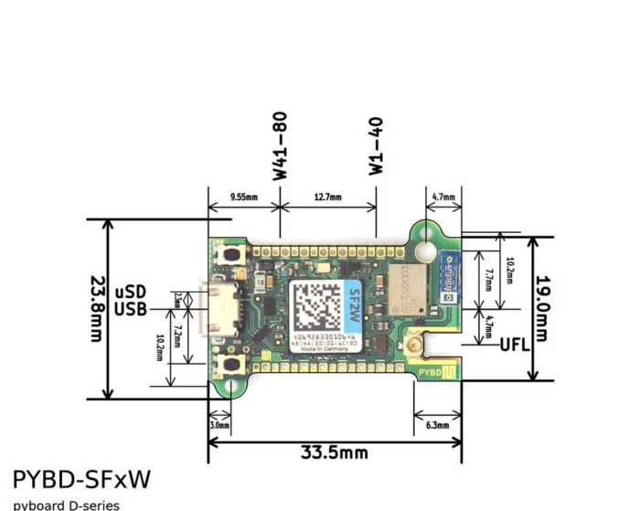
Python on PyBoard
The next great solution for Python in IoT devices is the PyBoard with an STM32F405RG microcontroller.
The PyBoard is a compact and powerful electronics development board that runs Micro Python.
It connects to our PC via USB, giving you a USB flash drive to save Python scripts and a serial Python prompt (a REPL) for instant programming.
This works with Windows, Mac, and Linux.

Slide 5
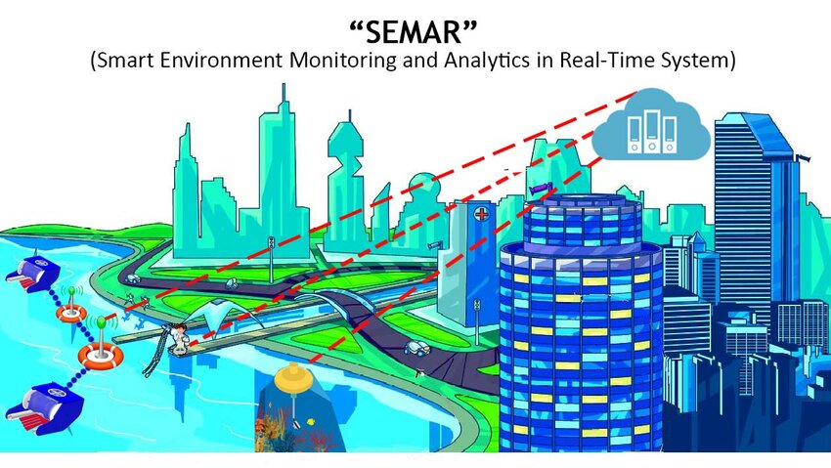

Slide 6
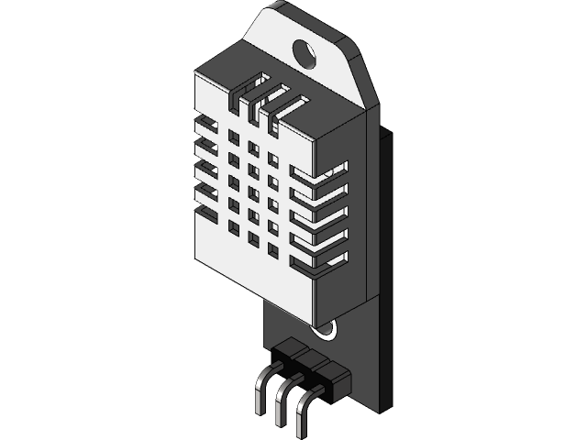
CAD Software in IOT Project
CAD Development in project
3D CAD software precisely represents and visualizes objects using a collection of points in three dimensions on the computer.
In order to we are generate the actual model and sensors design using CAD designs, CAM uses numerical coding to run the machine that creates the product.
A CAD is allows , our team to develop and save their own product designs, and program machines to create the actual component.
•°• HDT22/Temperature and humidity Sensor

Slide 7
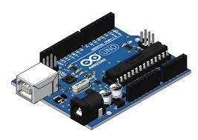
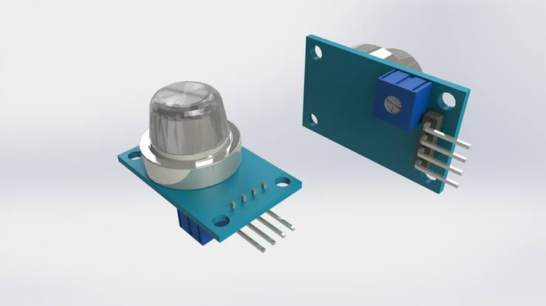
Development of Hardware designs using CAD
Gas Sensors
Arduino UNO

Slide 8
Developing visualizations
You can create custom visualizations to meet your specific business needs.
IBM Cognos Analytics allows developers to create and test custom visualizations
The Manage Visualizations capability allows users to control access rights to extensible visualizations for individual users, groups, and roles.
The Develop Visualizations capability allows users to develop extensible visualizations.
Custom visualization code samples are available in the Samples Guid

Slide 9
IBM Cognos Analytics
IBM Cognos Analytics is a powerful, comprehensive analytics platform designed
It provides interactive dashboards with embedded visualizations that enable users to quickly understand complex data sets

Slide 10
Benefits of using IBM Cognos Analytics
Enhanced Decision Making
Improved Efficiency
Scalability
Security & Compliance

Slide 11

Program
import Adafruit_DHT import time Import smtplib from email.mime.text import MIMEText from email.mime.multipart import MIMEMultipart from datetime import datetime # Set the sensor type and GPIO pin sensor = Adafruit_DHT.DHT11 pin = 4 # Change this to the GPIO pin you're using # Email configuration smtp_server = 'smtp.example.com' smtp_port = 587 smtp_username = 'your_email@example.com' smtp_password = 'your_email_password' sender_email = 'your_email@example.com' recipient_email = 'recipient@example.com'

Slide 12

def read_sensor_data(): humidity, temperature = Adafruit_DHT.read_retry(sensor, pin) return humidity, temperature def send_email(subject, body): msg = MIMEMultipart() msg['From'] = sender_email msg['To'] = recipient_email msg['Subject'] = subject msg.attach(MIMEText(body, 'plain')) with smtplib.SMTP(smtp_server, smtp_port) as server: server.starttls() server.login(smtp_username, smtp_password) server.sendmail(sender_email, recipient_email, msg.as_string()) while True: humidity, temperature = read_sensor_data() if humidity is not None and temperature is not None: current_time = datetime.now().strftime('%Y-%m-%d %H:%M:%S') print(f'[{current_time}] Temperature: {temperature:.2f}°C, Humidity: {humidity:.2f}%')

Slide 13

# Data logging to a file with open('environment_data.txt', 'a') as log_file: log_file.write(f'{current_time}, Temperature: {temperature:.2f}°C, Humidity: {humidity:.2f}%\n') # You can add conditions to send email notifications based on specific criteria if temperature > 30: subject = 'High Temperature Warning' body = f'Temperature is high: {temperature:.2f}°C' send_email(subject, body) else: print('Failed to retrieve data. Check the sensor and wiring.') # Adjust the sleep time as needed time.sleep(300) # Sleep for 5 minutes before the next reading

Slide 14
Conclusion
Thus the IOT based Environmental Monitoring System has been designed and implemented. The Environmental
parameters successfully transmitted via ESP 8266 Wi-Fi module.
This project will protect the people from the pollutant gases. It is
more useful for the Industries to control the air pollution in the surrounding area. With the sensors which can sense the
gas density in high level. ESP 8266-12E module has inbuilt Arduino microcontroller.

